Slide 1
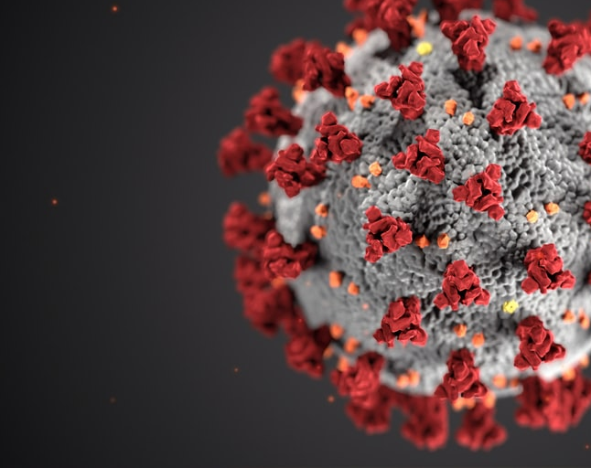

SNF COVID-19 Reporting
SURVEY 2.0
OVERVIEW
May 2020

Slide 2
Benefits of SNF COVID-19 Reporting
Provide data to monitor the impact of COVID-19 in SNFs in California.
Help the State of California/CDPH help you manage COVID-19 cases in your facility (respond to your staffing and supply needs.)
Transition to Survey 2.0 on May 14 in order to:
Fulfill submission requirements at both Federal (CMS/CDC/NHSN) and state (CDPH) levels in a consistent manner.
Reduce duplicate data entry - CDPH uploads data to NHSN on your behalf.

Slide 3
SNF Survey 2.0 - Transition Schedule
Reporting Period | Current Survey | Survey 2.0
Wednesday 5/13 from 12 noon to Thursday 5/14 12 noon | Use Current Survey (Wed 12N – Thurs 12N) | Disabled
Thursday 5/14 at 12 noon to Friday 5/15 at 12 noon THURSDAY after 12n BEST, instead of Friday AM | Disabled | Use 2.0 (Thurs 12N – Fri 12N) 1st day: Report cumulative case information from January 1, 2020 through May 15, 2020
Friday 5/15 at 12 noon to Saturday 5/16 at 12 noon FRIDAY after 12n BEST, for instead of SAT AM | Disabled | Use 2.0 2nd day report – report case information that is new since the first report
On-going, the Reporting Period is noon-to-noon, AM is best | Disabled | On-going - only report new case information (since previous 24 hour report)

Slide 4
CDPH Survey 1.0 versus CDPH Survey 2.0
SURVEY 1.0 (4/20 – 5/14 11:55am) | CDPH SURVEY 2.0 (starts 5/14 12n) Updated to align with CDC/NHSN
Cases Today Cumulative Cases (remember total to report each day) | 1st day: Report Cumulative from Jan 1, 2020 to first day Day 2 onward - only report new cases since last report
Basic information (facility ID, name, contact, and other facility info) | Basic information (facility ID, name, contact, and other facility info)
Survey Segments: Resident impact Staffing impact PPE | Survey Segments: Resident impact Staffing impact PPE Ventilator
Note: both CDPH surveys only require internet connectivity, whereas CDC/NHSN survey requires registration and approved access.

Slide 5
CDPH Survey 1.0 versus CDPH Survey 2.0 Resident Impact
CDPH SURVEY 1.0 (4/20 – 5/14) | CDPH SURVEY 2.0 (starting 5/14) Updated to align with CDC/NHSN
What is the current resident census in your facility? What is the current number of vacant beds in your facility? | Current Census: Total number of beds that are currently occupied. Isolation: number of beds that are capable of isolation, if applicable.
Have any of your residents ever had a laboratory confirmed COVID-19 diagnosis? Y/N How many residents with laboratory confirmed COVID-19 are currently in your facility? What is the cumulative number of residents who have ever had a laboratory-confirmed COVID-19 diagnosis? How many residents with suspected COVID-19 are currently in your facility? | Admissions: New residents, admitted or re-admitted, previously hospitalized and treated for COVID-19 Confirmed: Residents with new laboratory positive COVID-19 results Suspected: residents with newly suspected COVID-19 Isolation: Number of laboratory positive/suspected residents currently in isolation, if applicable.
What is the cumulative number of residents who have died, either at your facility or after transfer from COVID-19? | COVID-19 Deaths: Residents with suspected or laboratory positive COVID-19 who died in the facility or another location. Total Deaths: New residents who died in the facility or another location.
N/A | Does your facility have access to COVID-19 testing for residents in the facility? If YES, type of testing: State Health Dept Lab, Private Lab, Other

Slide 6
CDPH Survey 1.0 versus CDPH Survey 2.0 Staffing Impact
CDPH SURVEY 1.0 (4/20 – 5/14) | CDPH SURVEY 2.0 (starting 5/14) Updated to align with CDC/NHSN
Have any of your staff ever had a laboratory confirmed COVID diagnosis? Y/N How many of your staff scheduled to work this week ever had laboratory confirmed COVID diagnosis? What is the cumulative number of staff who have had a laboratory confirmed COVID diagnosis. | Confirmed: Staff and facility personnel with new laboratory positive COVID-19 Suspected: Staff and facility personnel with new suspected COVID-19
What is the cumulative number of health care workers at your facility who have died from COVID-19? | COVID-19 Deaths: Staff and facility personnel with new suspected or laboratory positive COVID-19 who died in the facility or at another location.
Have any nursing care staff, scheduled to work in the last 24 hours, not been able to report for work? Y/N The total number of nursing care staff that were scheduled to work at your facility in the last 24 hours. How many nursing care staff, scheduled to work in the last 24 hours, have not reported for work? Will you have a critical staffing shortage within in upcoming week? If Yes, type of resource needed: RN, LVN, CNA For each staff category: Count needed, Count remaining | Have any nursing care staff, scheduled to work in the last 24 hours, not been able to report for work? Y/N Enter the total number of nursing care staff (RN, LVN, CNA) that were scheduled to work at your facility is the last 24 hours Of the nursing care staff (RN, LVN, CNA) that were scheduled to work in the last 24 hours, how many have not reported to work?

Slide 7
CDPH Survey 1.0 versus CDPH Survey 2.0 Staffing Impact (cont.)
CDPH SURVEY 1.0 (4/20 – 5/14) | CDPH SURVEY 2.0 (starting 5/14) Updated to align with CDC/NHSN
N/A | Do you have an urgent staffing need over the next 48 hours? Y/N If Yes, type of resource needed: RN, LVN, CNA For each staff category: Staff currently available, Staff needed in the next 48 hrs., Additional staff shift needed (day, evening, night) Do you have a shortage of clinical staff (Physician, other clinical staff)? Do you have a shortage of other staff or facility personnel (regardless of clinical responsibility or resident contact not included in the categories above (for example, environmental services) Do you have a licensed administrator, Director of Nursing, or administrator-designee that is reporting on-site?
N/A | Do you anticipate a critical staffing shortage within the next 3-7 days? If Yes, indicate additional staff (RN, LVN, CNA) needed in next 3-7 days.

Slide 8
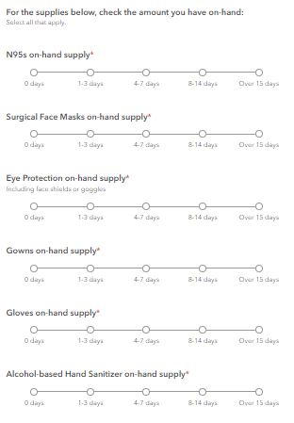
CDPH Survey 1.0 versus CDPH Survey 2.0 PPE Impact
CDPH SURVEY 1.0 (4/20 – 5/14) | CDPH SURVEY 2.0 (starting 5/14) Updated to align with CDC/NHSN
Are you short of masks, gowns, and/ or gloves? What PPE do you need? Surgical face masks Gowns Gloves N95s
On-hand supply for each of the above PPEs, select 0 days 1-3 days 4-14 days 15+ days

Slide 9
CDPH Survey 1.0 versus CDPH Survey 2.0 Ventilators
CDPH SURVEY 1.0 (4/20 – 5/14) | CDPH SURVEY 2.0 (starting 5/14) Updated to align with CDC/NHSN
N/A | Do you have a Ventilator Dependent Unit in your facility? Y/N
N/A | If Yes: Mechanical Ventilators -Total number available in your facility Mechanical Ventilators IN USE- Total number of ventilators in use for residents who have suspected or lab-confirmed COVID-19. Do you currently have any ventilator supply needs? Y/N Any, including tubing If Yes, Amount of current ventilator supplies 0 1-3 days 4-7 days 8-14 days 15+ days

Slide 10
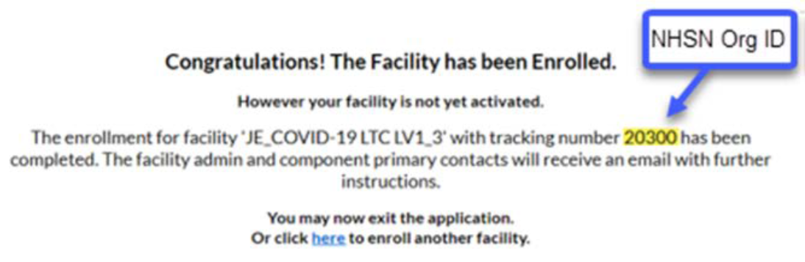
National Healthcare Safety Network (NHSN)
The CDPH COVID-19 Survey will ask for your NHSN OrgID, just one-time.
Why? Before CDPH can upload data on your behalf, you need to register with CDC/NHSN and share your ID. Go to the NHSN website. After successful enrollment with them, you will receive a NHSN Org ID.

Slide 11
SNF Survey 2.0 – Day 1 v. Day 2 Reporting
DAY 1 (Thurs 5/14 12n - Fri 5/15 12n) THURSDAY after 12n BEST | Day 2 onwards noon – noon
1st day: Report cumulative case information from January 1, 2020 through May 15, 2020 Admissions: Residents Confirmed: Residents, Staff Suspected: Residents, Staff Total Deaths: Residents COVID-19 Deaths: Residents, Staff | 2nd day and onwards: only report case information that is new since the previous report

Slide 12
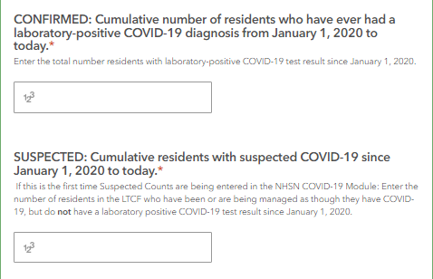
SNF Survey 2.0 – Day 1 v. Day 2 Reporting
DAY 1 (Thurs 5/14 12n - Fri 5/15 12n) THURSDAY after 12n BEST | Day 2 onwards 12n – 12n
 | 2nd day and onwards: only report case information that is new since the previous report

Slide 13
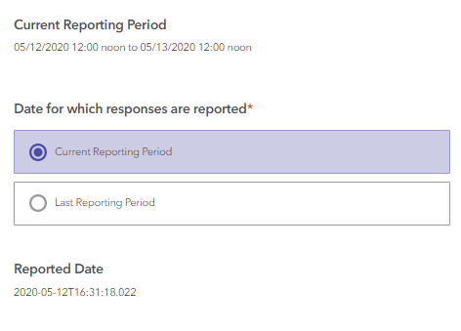
CURRENT REPORTING PERIOD
The reporting period is 12n-12n, daily.
Select one of two options: Current Reporting Period or Last Reporting Period.
The Reporting Period is relative to the time the daily report is submitted, determined by whether/not it is submitted before or after 12Noon. For example, if you complete the survey at 11am, on Monday, Monday is the Current Reporting Period. If you complete the survey at 1pm on Monday, Tuesday is the Current Reporting Period and Monday is the Previous Reporting Period
CDPH expects you to report once per day.

Slide 14
SNF Survey 2.0 – Tips and Tricks
Have your daily data available.
Report at a consistent time each day.
Use Chrome, Firefox, or cell phone. Internet Explorer is not recommended.
The survey is shorter, easier.
Built-in data validation may trigger error messages. Adjust the data and move on to the next question.
Keep a record of what you submit. Before clicking the SUBMIT button, you can:
  From Chrome/Firefox browser, print the full-page survey screenshot to a PDF.
  From iPhone/Safari, save the full-page survey screenshot to a PDF using this instructional youtube video.

Slide 15
Where to Find Your Facility’s Year-to-Date Total
The CDPH COVID-19 Daily Report List is available here:
https://www.cdph.ca.gov/Programs/CID/DCDC/Pages/COVID-19/SNFsCOVID_19.aspx
Or – all 7 metrics on an Excel file, are here: CDPH SNF COVID-19 Web Page
https://www.cdph.ca.gov/Programs/CHCQ/LCP/Pages/SNF-COVID-19-Daily-Reporting.aspx
Remember to check this out before reporting to the CDPH Survey 2.0 for the first time.

Slide 16
Where is the CDPH SNF COVID-19 Survey 2.0?
Where is CDPH survey 2.0?
CDPH SNF COVID-19 Survey
  More information about the survey can be found at:
CDPH SNF COVID-19 Web Page
Is there training available for CDPH survey 2.0?
A link to this video recorded training will post on the CDPH web page in approximately one week.

Slide 17

Thank You
If you have any questions, contact your CDPH district office SPOC
or send an email to:
COVID-19SNFSURVEY@CDPH.CA.GOV

